Slide 1
DBMS MINI PROJECT
CHEMISTRY LABORATORY
MANAGEMENT
SYSTEM
SUBJECT CODE : 17CSL58
Akash Lal 1MV17IS005
Mohit Sinha 1MV17IS030
Ruchika Jain 1MV17IS045

Slide 2
ABSTRACT
Chemistry Laboratory Management System is a project which aims in developing a computerized system to maintain all the daily work of the Chemistry lab in our Institution, Sir M Visvesvaraya Institute of Technology, Bangalore. This project has many features which are generally not available in normal laboratory management systems like facility of login so that nobody can mishandle the data. As soon as we login, an interactive Chemistry Lab Home Page opens. There are various options like Chemicals, Instruments, Glassware and Suppliers which can be chosen from the top navigation bar and the respective tables with their stocks are displayed to the user. The various options like add new, update existing and deleting records can be easily performed by the users. The laboratory in charge after logging into his account, i.e admin account can generate various reports based on availability of materials in the Laboratory.

Slide 3
TOOLS USED :
Text Editor : Visual Studio Code
Front End : HTML, CSS & Javascript
Database : SQLite
Scripting : Flask – A Python micro framework.

Slide 4
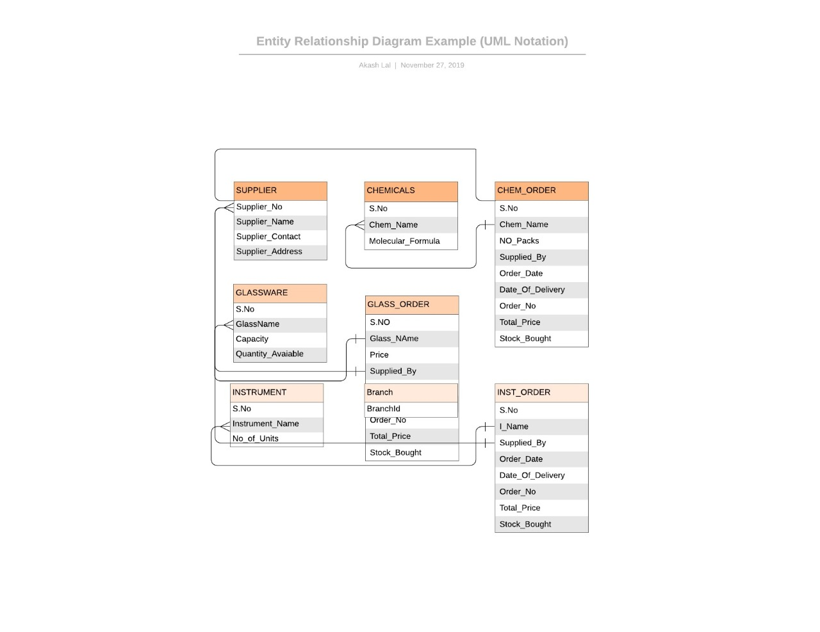
SCHEMA DIAGRAM

Slide 5
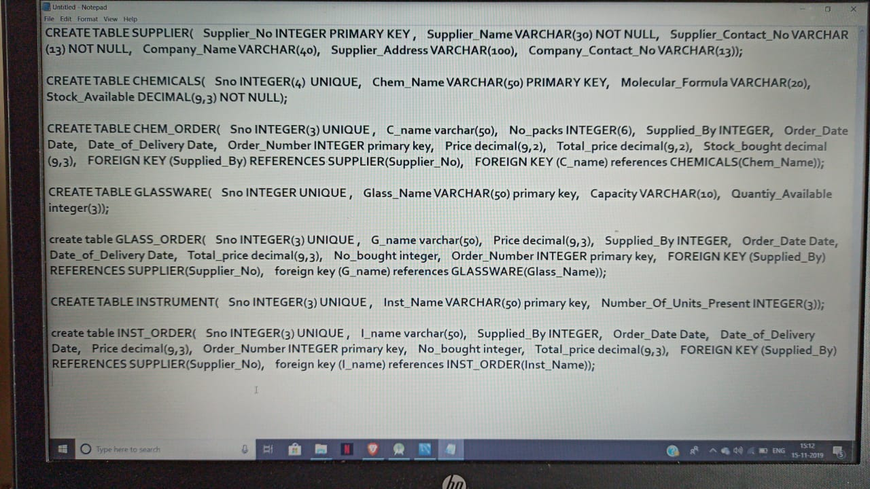
TABLE VALUES:

Slide 6
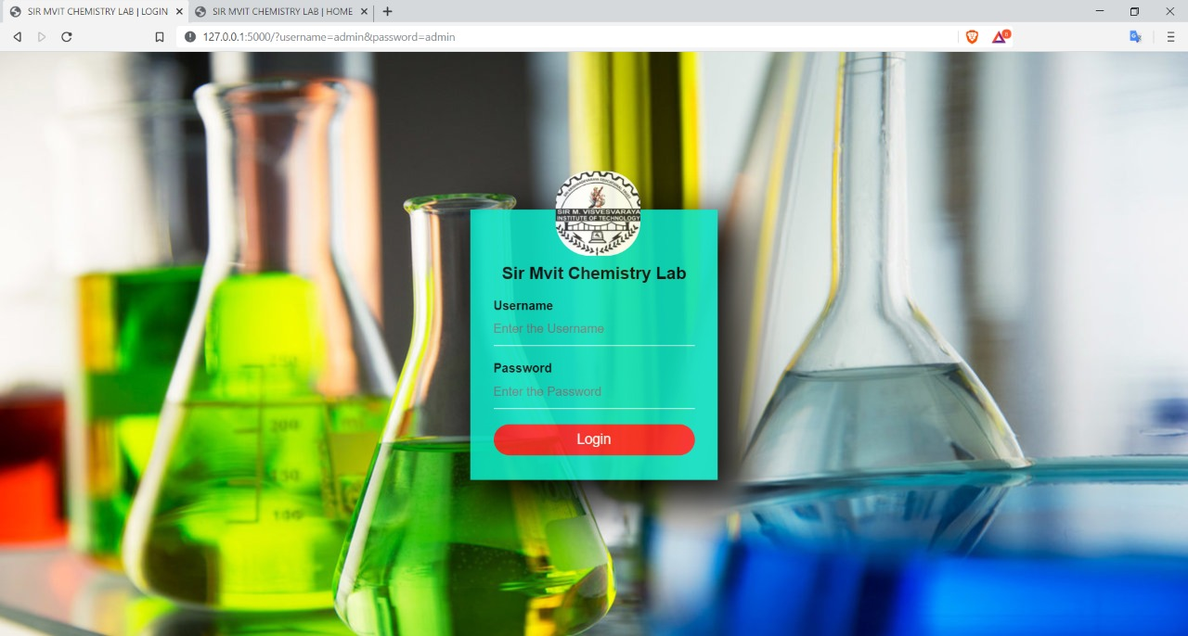
PROJECT SCREENSHOTS
LOGIN SCREEN :

Slide 7
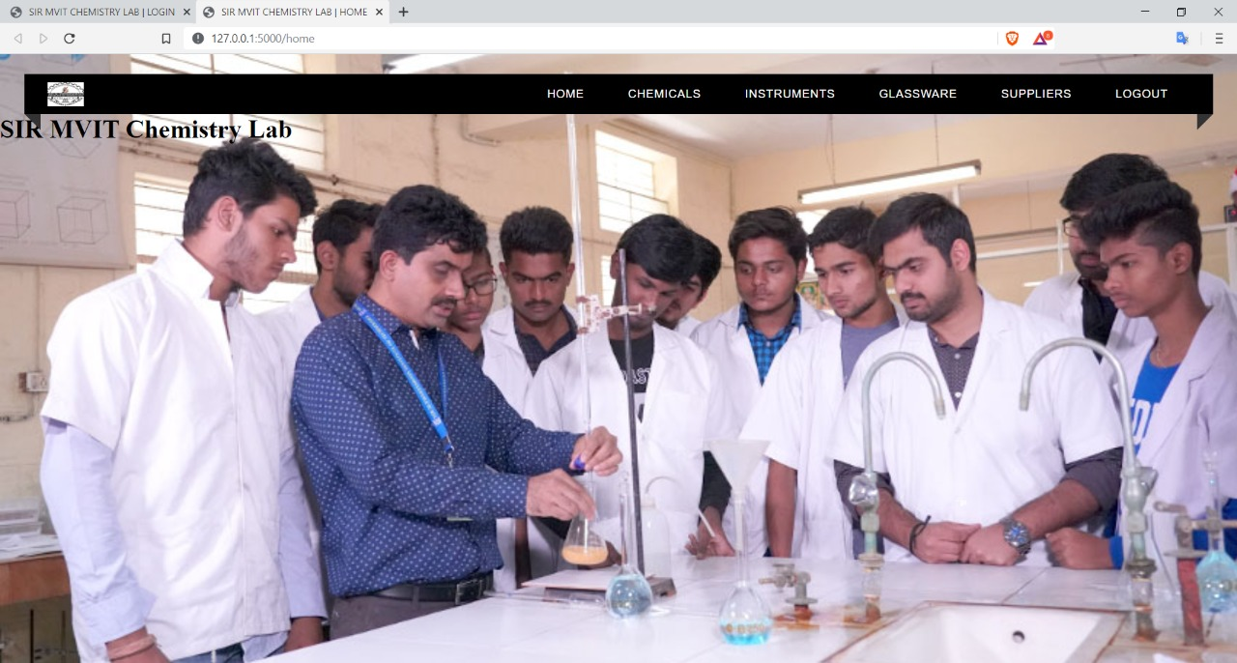
HOME SCREEN :

Slide 8
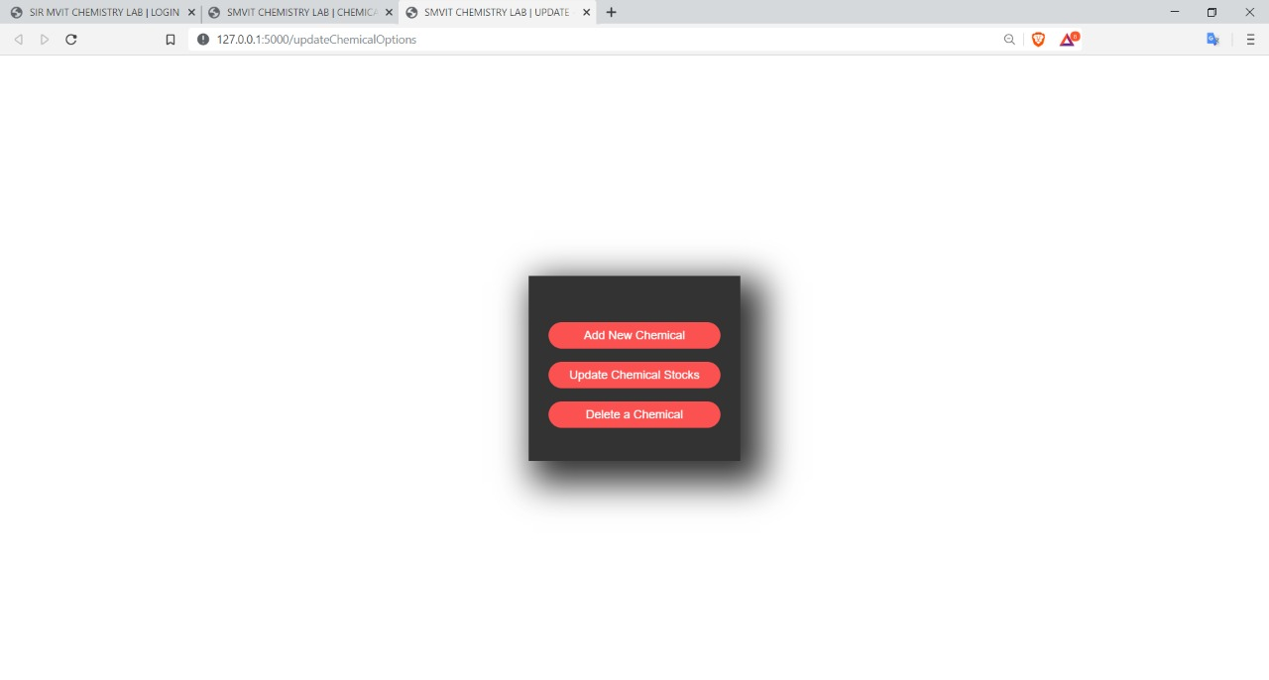
UPDATE CHEMICAL OPTIONS

Slide 9
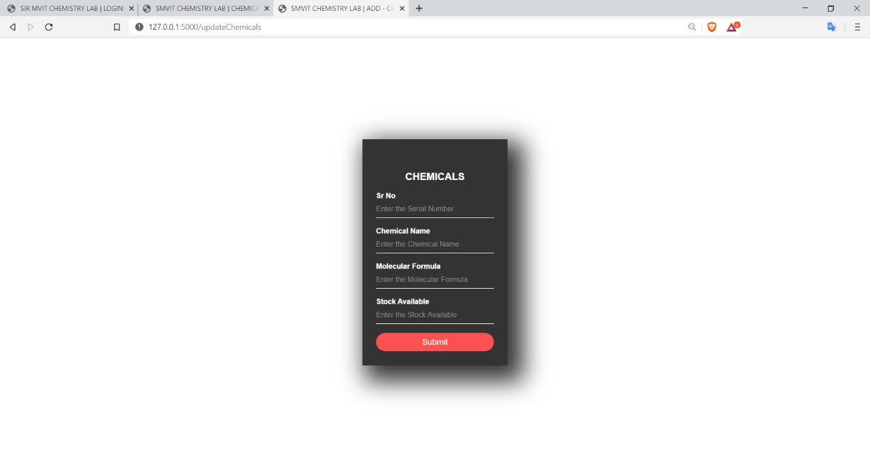
ADD NEW CHEMICAL

Slide 10
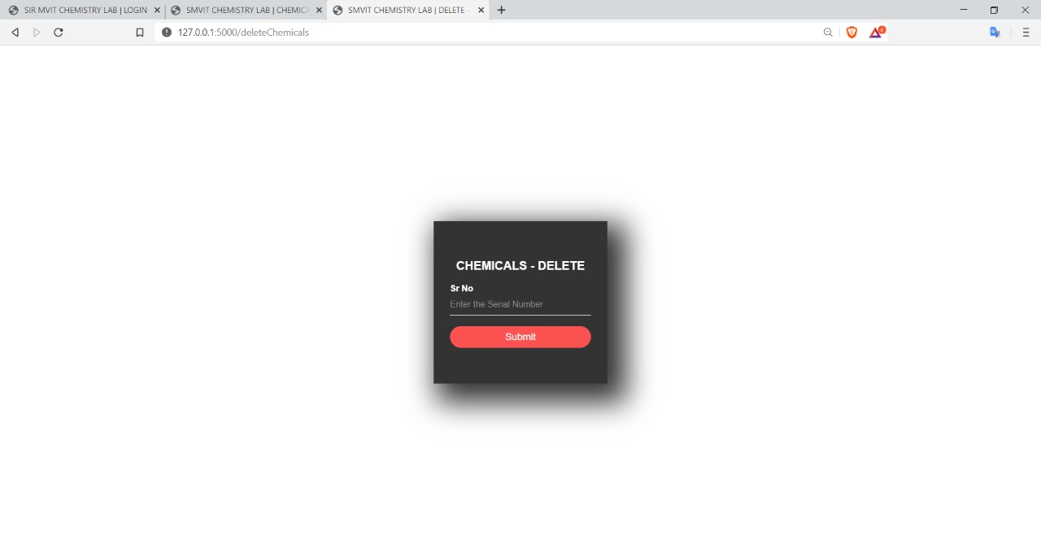
DELETE CHEMICAL

Slide 11
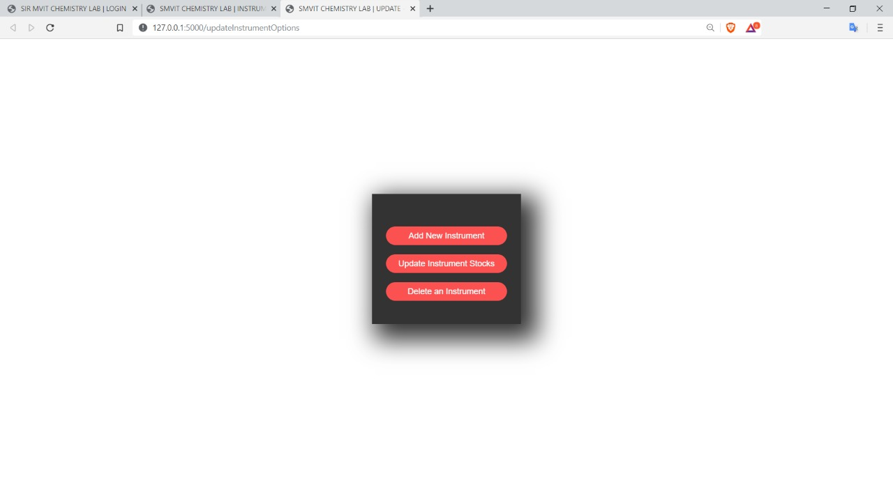
UPDATE INSTRUMENT TABLE OPTIONS

Slide 12
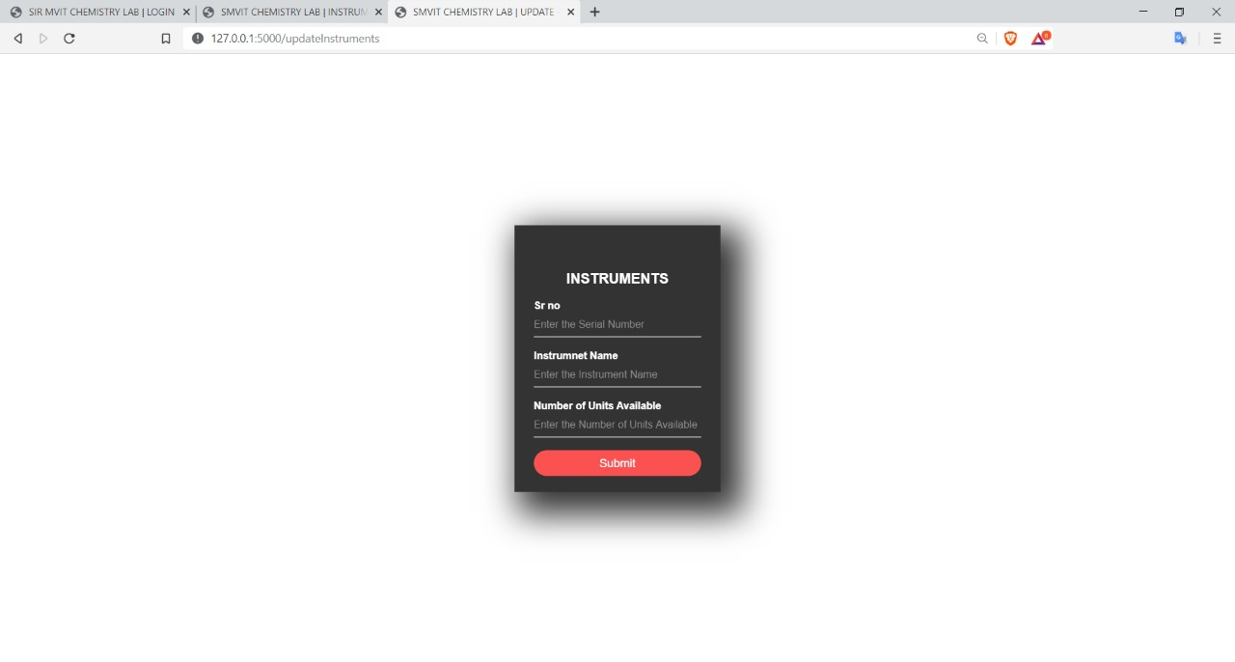
ADD NEW INSTRUMENT

Slide 13

DELETE INSTRUMENT

Slide 14
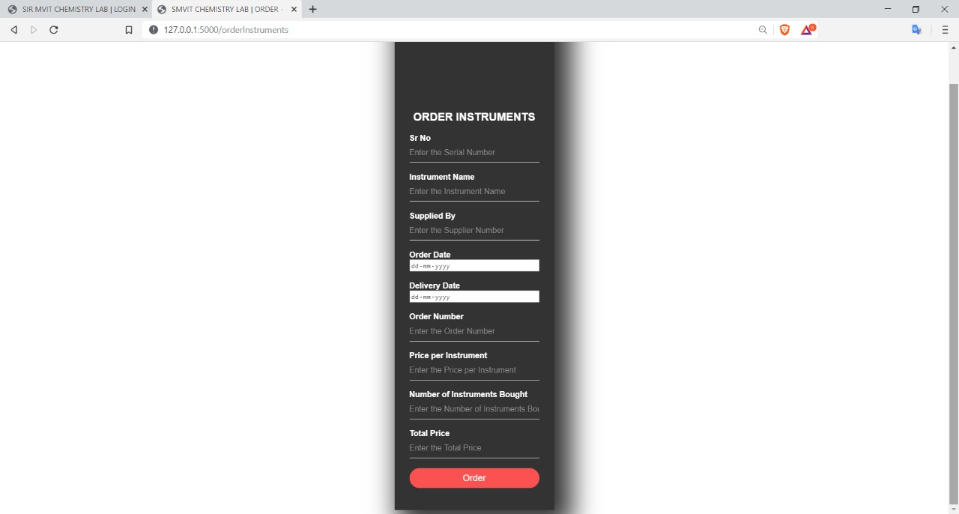
ORDER INSTRUMENTS

Slide 15

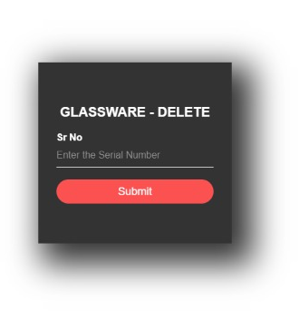
ADD & DELETE GLASSWARE

Slide 16
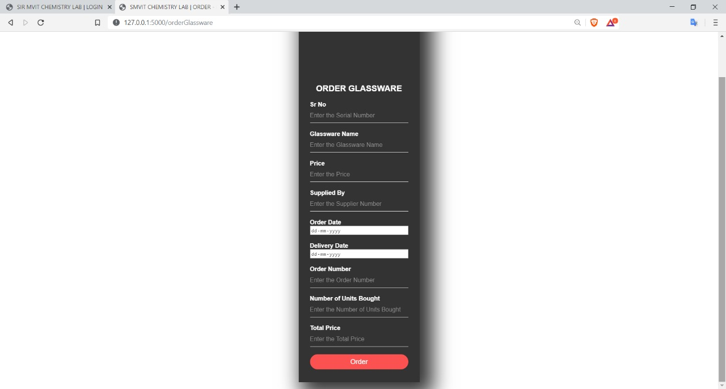
ORDER GLASSWARE

